Slide 1

KODAK NEXPRESS
Digital Production Color Solutions
Environmental Sustainability & Recycling
Chuck Hura
Notes:
Thanks for taking the time to learn about the newest Kodak NexPress products – the S-class of digital production presses -- and learning why we are confident when we tell customers that they can “Profit from Change.”

Slide 2

Agenda
Sustainability & Environmental Issues
  Certificates / Proof
  Number of Impositions
  Recycling and Reuse
  Environmentally Friendly Process and Output
  The Future Dry Inks
Notes:
Over the next few slides, I will tell you about the new S-Class product family. I’ll give you an overview of our newest products and tell you how they are positioned in our portfolio - with some key messages about why this is important to our customers. There are key features and benefits that set us apart in the high volume color market space that I’ll discuss. Finally, I will talk about the competition and why Kodak is better positioned to win.
When we are done, you will be able to:
Describe the new S-Class product family offering from Kodak
Understand why Kodak is uniquely positioned for the largest market coverage
Communicate the primary features & benefits of S-Class presses
and articulate why Kodak S-Class presses position you to WIN!!

Slide 3
Win with Kodak NexPress Solutions

Slide 4


Good for the You / Good for the Environment
Sustainable and Green Solutions
INGEDE certificate of de-inkability
  International association of de-inkability certifies NexPress and Digimaster prints as good deinkable (Highest Level) with standard deinking processes.
EU food approval
  Food approval in European Union, NexPress printing system is approved for use in the food industry in the European Union.
EN71.3 Toy safety approval
  EN71.3 limits toxic metals in toys. Required
  for everything that can intentionally get into
  the hands of children. NexPress production
  color presses comply with EN71.3.
Dry Inks are non-toxic and easy to handle
This is the key point. HP claims de-inkable, but they paid a lab to figure out a way to de-ink their prints. What good is this if it isn't used in the industry!

Slide 5




Good for the You / Good for the Environment
Sustainable and Green Solutions
High gloss finish is non-toxic & recyclable
No harmful compounds generated
or required during manufacture, use, clean-up, and disposal of dry-inks
No hazardous material removal
or protective clothing required
No irritating or annoying odors
No VOCs emitted from dry inks
Reduced Consumables Packaging
Voluntary partnerships

Slide 6


Number of Impositions: The Issue
Number of Impositions due to difference in Sheet size and Image area sizes. For example, a 3x7 postcard or rack card:
This causes an additional number of sheets to be printed, which
  Increases Click Costs on the Indigo
  Increases Labor Costs
  Increases Paper Costs
  Effectively Slows down the Indigo
NexPress S-class
or 2100+, 2500
Indigo 3500, 5500, 7000
8 per sheet
6 per sheet

Slide 7
Number of Impositions for Typical Applications
3x7 Rack Card, Postcard
NexPress S-class
or 2100+, 2500
Indigo 3500, 5500, 7000
8 per sheet
6 per sheet
4x6 Photo, Postcard
NexPress S-class
or 2100+, 2500
Indigo 3500, 5500, 7000
9 per sheet
4 per sheet
8.5x11 or A4
NexPress S-class
or 2100+, 2500
Indigo 3500, 5500, 7000
2 per sheet
2 per sheet
6x9 finished book with up to 1" spine
NexPress S-class
or 2100+, 2500
Indigo 3500, 5500, 7000
2 per sheet
1 per sheet

Slide 8
Number of Impositions for Typical Applications
B3
NexPress S-class
or 2100+, 2500
Indigo 3500, 5500, 7000
1 per sheet
0 per sheet
A6 finished size
NexPress S-class
or 2100+, 2500
Indigo 3500, 5500, 7000
9 per sheet
8 per sheet
A7 finished size
NexPress S-class
or 2100+, 2500
Indigo 3500, 5500, 7000
18 per sheet
12 per sheet
14x20 poster
NexPress S-class
or 2100+, 2500
Indigo 3500, 5500, 7000
1 per sheet
0 per sheet

Slide 9
Number of Impositions: The Bottom Line
More Sheets are printed / used on HP Indigo
  10% to 50% more sheets
  = 10% to 50% more clicks
  = 10% to 50% slower
More Waste is generated
More Energy is used
More Labor is used

Slide 10

Kodak NexPert Operator Software
Expert System guides Operator to Best Practices to get the most life from their components.
  Cleaning and Maintenance
  Which components to target first

Slide 11
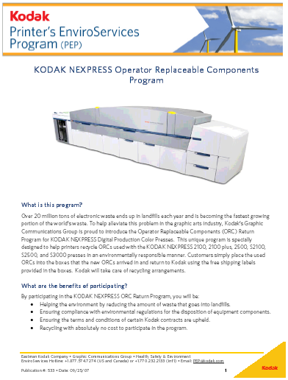
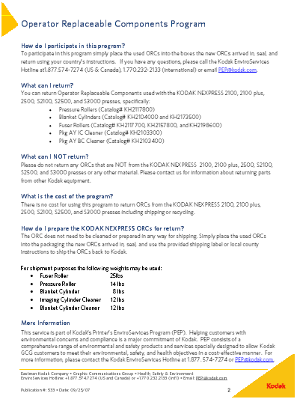
ORC Return Program

Slide 12
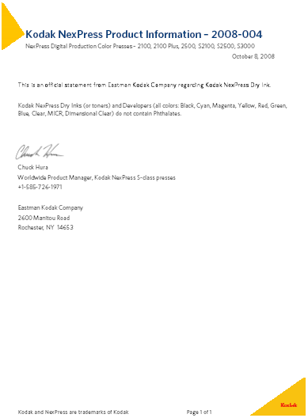
Dry Inks are Phthalate Free

Slide 13
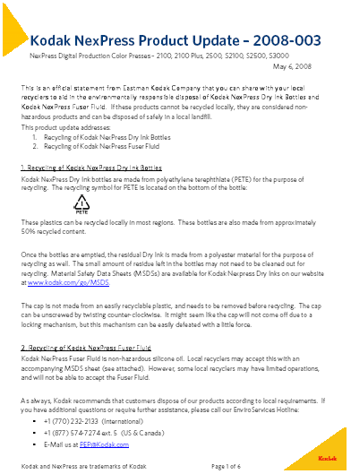

Empty Dry Ink Bottle Recycling
Bottles are made from 50% recycled plastic

Slide 14

Notes:
Thanks for listening and learning about Profiting from Change with Kodak NexPress S-class digital production color presses.

